Slide 1
Self-Efficacy of African American Female Undergraduates in STEM Majors
Dr. Carmen Bucknor Dr. Karen Benn-Marshall
Research Assistants: Ashley Dean, Renissa Arnold, I’Janay Belle, and Catherine DeCanal.
Department of Psychological Sciences, Oakwood University
Notes:
Good morning. I (Carmen Bucknor) have been interested in doing research on the variables gender and choice to study in the STEM disciplines since graduate school (now five years ago). I worked with Dr. Marie Hammond on a NSF-supported grant to research the persistence of minority students in STEM to terminal degrees. That project examined the data for African American women undergraduates of that sample. The literature at that time up to now seemed heavily qualitative. In this research, I thought to use quantitative analysis to understand the self-efficacy AA female STEM undergraduates report. The research question is what leads to feelings of self-efficacy? In this presentation, Karen Benn-Marshall, Ed.D. is second author.

Slide 2
Abstract
Current research supports statements from the NSF and other scientific agencies that the STEM academic disciplines and subsequent workforce must increase in diversity in the near future if our country is to see gains in employment. The purpose of this research study is to develop predictive models for the perceived self-efficacy of African American STEM female undergraduates. Regression models that included High School Math, perceived barriers and parental education level were significant. Understanding relevant factors to increasing women participating in STEM- related fields is the hope of the research.
Notes:
This presentation is of research completed under and funded by a Faculty Development Research Grant at Oakwood University. Under the grant, I had four student research assistants. The work they did was invaluable (data collection and project management) to the completion of this project ON TIME.

Slide 3
Introduction/Background
Jackson, 2013
Minorities will make up 50% of the U.S. population by the year 2050, their presence in STEM fields will also increase.
Joseph, 2012
Black women rely heavily on historically black colleges and universities as a source of STEM degrees.
Owens, et al. 2012
Performed an archival analysis of Integrated Postsecondary Education Data System from 2001 to 2009 and found that one fifth of African-Americans received bachelor’s degree (of any kind) from HBCU’s.
Notes:
A short review of the literature that establishes the significance of the study: it is appropriate to examine the academic developmental pattern of minorities as they will make up half of the US population in less than 50 years. The environments that have been a successful option of African Americans for collegiate education for more than a century are appropriate for study.

Slide 4
Introduction/background
Research suggests that HBCUs are fruitful venues for learning what is effective for recruitment and retention of minority students as well as production of minority STEM students and graduates who plan to further their STEM studies into graduate school or who plan to enter a STEM career.

Slide 5
Introduction/Background Cont.
Thomas & Jackson, 2007
Call for social and behavioral research to identify critical factors (personal, family, school, and community) that facilitate and/or inhibit the educational success of African American women and girls.
Borum & Walker, 2012
In a qualitative study, determined that mentorship and department support are important to the success of black women in mathematics.
Ehrenberg, 2010
Highlighted the shortage of college graduates trained in STEM and recommended increasing the number of high school students who take AP Science and Math classes.
Thomas & Jackson, 2007
Qualitative research is needed to give “voice” to the experience of African American boys and girls.
Quantitative research adds to the validity of that “voice” subjecting known factors to rigorous and established statistical analysis.
Notes:
As stated before, while qualitative analysis is an appropriate avenue for the collectivist cultures, including the African American culture, the variables that emerge from the qual research should also be analyzed using quantitative methods.

Slide 6
Research Question & Hypothesis
What are the predictive factors of the self-efficacy of African American female STEM majors?
Self-efficacy is the beliefs one has about one’s capable abilities (Lent et. al, 2005).
Multiple regression analysis will indicate a significant predictive model for the self-efficacy of the African American STEM female undergraduates.
Multiple regression analysis is a method for estimating the relationship between a dependent variable and one or more independent variables. (Shroeder, Sjoquist, & Stephan, 2017)
Notes:
HBCU Students in the sample for Lent et al (2005) reported stronger self-efficacy and Albert Bandura (1997) has suggested that academic behavior is best predicted by
measures that tap multifaceted aspects of self-efficacy, such as perceived ability to attain academic milestones and to surmount performance hurdles.
This project leaned on the understanding of career development outlined by the Social Cognitive Career Theory (SCCT) as explained by Lent Brown and Hackett (1994) which says that self-efficacy is influential on career choice (to loosely paraphrase).
multiple regression analysis was the choice for statistical analysis as there is one outcome variable (self-efficacy) and at least 2 predictor variables. Those variables were measured by a demographic scale and a questionnaire of contextual supports and barriers students experience in areas of family, finances, institutional support and mentoring.

Slide 7
Methods - Participants
Cross-sectional design using convenience sample of currently enrolled male and female college students aged 18 and older, recruited by research assistants.
Students who were expected to major in Biology, Chemistry, Mathematics, Computer Science, Engineering, and Psychology were recruited for the study.
Notes:
After IRB approval, Original data collection included male and female students aged 18 and older. The PI emailed instructors/professors of classes expected to have STEM students enrolled, and Student research assistants went to the permitted classes with packets that included a recruitment script, IFC, the study measures, and Debriefing forms.

Slide 8
Methods - Materials
Demographic form: 12 items – age, gender, ethnicity, current education level, major, primary language, estimated GPA, parental education level, religious affiliation, math/science preparedness, and estimated family income.
Contextual Support and Barriers questionnaire: a 16-item measure that asked students to rate their level of agreement with several statements that mention the presence of general areas of support and barriers to academic success (friends and family, financial, institutional, and mentoring). The measure used for this study was developed from measures by Lent (2005) that measure contextual support and barriers to feelings of self-efficacy.
Notes:
The demographic form included the following
The Contextual Support and Barriers questionnaire was developed using Lent et al (2005) example.

Slide 9
Methods - Materials
Self-Efficacy Scale: a 30-item instrument that measures general expectations of self-efficacy that are not tied to specific situations or behavior (Sherer et al, 1982). One of the assumptions underlying the instrument is that individual differences in past experiences and attributions of success lead to different levels of generalized self-efficacy expectations. The general self-efficacy subscale was used for this study. The SES authors report fairly good internal consistency for this subscale (.86). The authors also report the SES to have good criterion-related and good construct validity.

Slide 10
Methods - Procedures
IRB approval
PI emailed message to instructors of classes unique to the Biology, Chemistry, Mathematics, Psychology, and Computer Sciences academic majors for permission of research assistants to visit the classes for recruitment and study administration.
To those classes where access was granted, student research assistants arrived at agreed-upon times and administered the study measures to those students who signed the informed consent form and agreed to participate.
Raw data was entered into the Statistical Package for Social Sciences (SPSS).

Slide 11
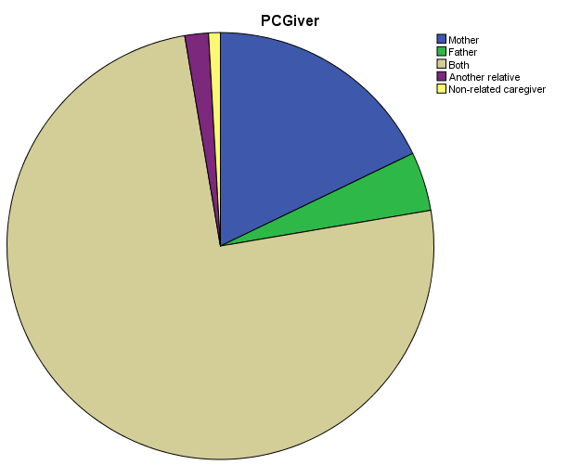
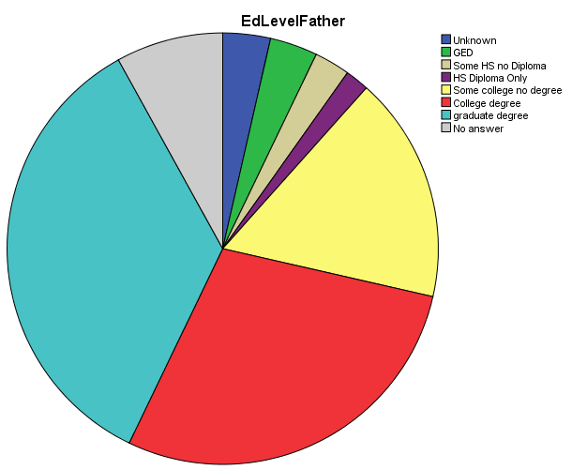
Results
Notes:
The entire sample of 112 students (approx. 49%) were male had reported demographic data worth noting: AA students
PC approx. 75% of the sample reported being raised by both parents in the home, in contrast to the latest census data that indicates approx. 35-50% of African American homes have both parents present.
Most parents had at least some college experience, with 2/3 of the samples’ parents having at least a college degree.

Slide 12
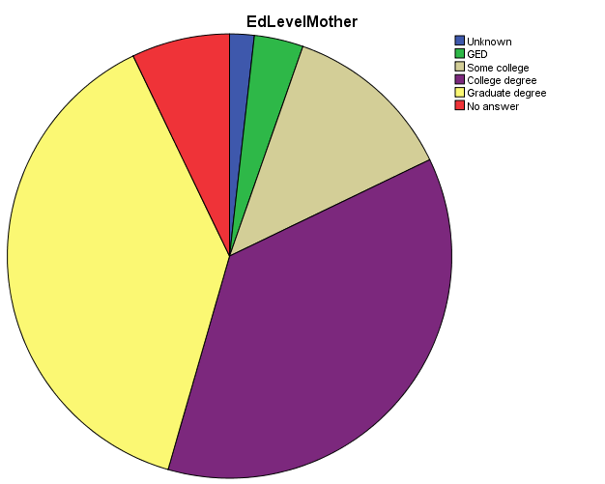
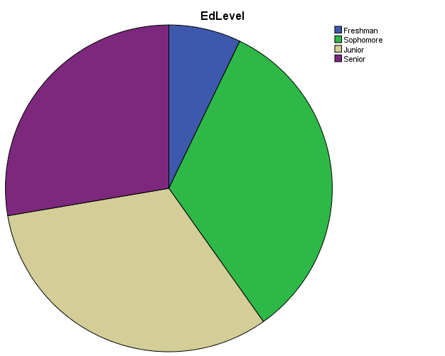
Results
Notes:
Pie chart on the left is education level of the mother for the sample with ¾ of the sample’s mothers having at least a college degree.
The chart on the right is the division of classification, the small blue slice is freshmen, the green section is sophomore, tan is junior, purple is senior.

Slide 13
Results
Measure Composite Scores
 | SES Composite | Support Composite | Barriers Composite
Mean | 64.8627 | 39.8824 | 42.9804
Standard Deviation | 9.15865 | 13.57740 | 8.59881
Years of Courses Taken
 | High School Science | High School Math
Mean | 3.62 | 3.75
Standard Deviation | .712 | .571
Notes:
One of the variables expected to be correlated was science/math preparedness. Under Years of Courses taken, the sample mean years was 3.62 years for science and 3.75 years for math. This data is for the female participants.
The Measure composite scores show the self-efficacy scale composite, with higher scores indicating greater feelings of self-efficacy. The support composite and barriers composite were from the Contextual measure, with larger numbers indicating barriers. Note the larger standard deviations for this sample.

Slide 14
Results – Hypothesis test
The regression model that included the predictor variables of perceived barriers and parental education levels was significant [F(3, 47) = 3.911, p<.05)]. R value for this model was .447 and adjusted R² was .149.
The next most predictive model of perceived barriers, parental education levels and high school math preparedness was significant [F (4, 46) = 3.297, p<.02)]. R value for this model was .472 and adjusted R² was .155.
Notes:
The multiple regression analysis yielded two significant models that included barriers, and parental ed levels. The second model included those variables and math preparedness.
This analysis result is modest, but I’m personally proud of it….the R² number may be low, but the sequence of variables for this model suggests 14-15% of the variance of self-efficacy (as it appears in this sample) can be accounted for by these variables. This is a good start.

Slide 15
Discussion/conclusion
The significance of perceived barriers adds to the significant regression models for prediction of minority female STEM student self-efficacy.
The inclusion of parental education level but not estimated family income. The regression model found the education level of the father and of the mother to fit into a significant equation that predicted feelings of self-efficacy.
It seems that the amount of money one's parents have does not have much to do with feelings of self-efficacy
Female STEM majors themselves may be instrinsically motivated to achieve their STEM goals (of a baccalaureate degree, at least).

Slide 16
Limitations
Behavioral scientists routinely publish broad claims about human psychology and behavior in the world's top journals based on samples drawn entirely from Western, Educated, Industrialized, Rich, and Democratic (WEIRD) societies (Henrich, Heine, & Norenzayan, 2010)
College students are a unique population; about 33% of US adults 25 and over have a Bachelors degree (Ryan & Bauman, 2016)
There are limits to tests of statistical significance: finding a statistically significant result does not necessarily imply social, clinical, or even practical significance (Schroeder, Sjoquist, & Stephan, 2017)
Notes:
While a good start, it is only a small start. There are limitations. Small sample size relative to the numbers of STEM students at the University as well as what is listed here.

Slide 17
References
Borum, V., & Walker, E. (2012). What makes the difference? Black women's undergraduate and graduate experiences in mathematics. The Journal of Negro Education, 81(4), 366-378.
Ehrenberg, R. G. (2010). Analyzing the factors that influence persistence rates in STEM field, majors: Introduction to the symposium. Economics of Education Review, 29(6), 888-891.
Jackson, D. L. (2013). A balancing act: Impacting and initiating the success of African American female community college transfer students in STEM into the HBCU environment. The Journal of Negro Education, 82(3), 255-271.
Joseph, J. (2012). From one culture to another: Years one and two of graduate school for African American women in the STEM fields. International Journal of Doctoral Studies, 7, 125-142.
Lent, R. W., Brown, S. D., Sheu, H. B., Schmidt, J., Brenner, B. R., Gloster, C. S., ... & Treistman, D. (2005). Social cognitive predictors of academic interests and goals in engineering: Utility for women and students at historically black universities. Journal of Counseling Psychology, 52(1), 84.
Owens, E. W., Shelton, A. J., Bloom, C. M., & Cavil, J. K. (2012). The Significance of HBCUs to the Production of STEM Graduates: Answering the Call. Educational Foundations, 26, 33-47.
Ryan, C., & Bauman, K (2016, March). Educational attainment in the United States: 2015. US Census Bureau.
Schroeder, L., Sjoquist, D., & Stephan, P. (2017) Understanding Regression Analysis, 2nd edition. Sage: Los Angeles.
Sherer, M., Maddox, J.E., Mercandante, B., Prentice-Dunn, S., Jacobs, B. & Rogers, R.W. (1982). The Self-Efficacy Scale: Construction and validation. Psychological Reports, 51, 663-671.
Thomas, V. G., & Jackson, J. A. (2007). The education of African American girls and women: Past to present. The Journal of Negro Education, 357-372.

Slide 18
Questions?

